Slide 1

PRELIMINARY SDP EVALUATION AI-Enabled b2b invoice management system
Supervised By: Prof. Sudipta Mandal
Group No. #E14
Name of the Student(s) with Regd. No.
1941012876 – Abhilipsa Pani
1941012232 - Rashi Mishra
19410121130 - Pranjal Pandey
Department of Computer Sc. and Engineering
Faculty of Engineering & Technology (ITER)
Siksha ‘O’ Anusandhan (Deemed to be) University
Bhubaneswar, Odisha
1

Slide 2
Presentation Outline
Introduction
Motivations
Uniqueness of the work
Literature Survey
Existing System
Problem Identification
Schematic Layout OR Model Diagram
Methods OR Tools OR Algorithms used
Experimentation and Results
System/Model Specifications
Datasets Description (if any)
Parameters used (if any)
Experimental outcomes (Tables and Figures)
Result Analysis and Validation
Conclusion and Future Scope (Key Findings)
Bibliography
2

Slide 3
Introduction
Overview
An AI-enabled invoice management system uses cutting-edge AI technology to automate and optimize the invoicing process.
The system can extract data from invoices, classify them, and automatically route them to the appropriate parties using machine learning technologies, eliminating the need for manual data entry and reducing the possibility of fraud or errors.
The system can analyze data from invoices, providing valuable insights into spending patterns and identifying opportunities for cost savings. It can also seamlessly interact with other business systems, such as accounting software, to facilitate smooth data transmission.
3

Slide 4
Motivations
Increased efficiency and accuracy: AI-enabled B2B invoice management systems can significantly reduce the need for manual data entry and processing, resulting in faster and more accurate invoice processing.
Cost savings: By automating the invoicing process, businesses can save time and money, allowing them to allocate resources to other areas of their operations.
Fraud prevention: AI-enabled B2B invoice management systems can help prevent invoice fraud by detecting anomalies and flagging suspicious transactions.
Data analysis: By analyzing data from invoices, businesses can gain valuable insights into their spending patterns and identify areas for cost savings or process improvements.

Slide 5
YEAR | TITLE | PUBLISHER | DATASET | ALGORITHM USED | RESULT
2018 | Proactive Collections Management Using Artificial Intelligence to Predict Invoice Payment Dates | Credit Research Foundation | Invoice and Billing Data from A Company | Linear Regression KNN Random Forest | Random forest model gives higher accuracy
2021 | A Financial Ticket image intelligent recognition system based on deep learning | Elsevier | A large number of invoice images | CNN RNN | Improved data quality Consistent Processing time
2020 | AI Based Invoice management system using OCR Technology | Ieee.org | 3000 invoices | Rule based algorithm | Accuracy of 97.4%

Slide 6
YEAR | TITLE | PUBLISHER | DATASET | ALGORITHM USED | RESULT
2022 | AI Driven Accounts Payable Transformation | AAAI-22 | Data from Two Companies | lexical normalization Random-forest Logistic regression SVM | This System currently has volume of 800k invoices.
2021 | Contribution of Artificial Intelligence in B2B Sales: A Danfoss Case Study | International Journal of Advanced Engineering Research and Science | Annual reports of Danfoss | Salesforce MyPipeline | better pricing, time optimization, process efficiency, forecast and pipeline
2021 | Artificial Intelligence in E-Commerce: A Business Process Analysis | Prateek kalia | No particular Dataset was used. |  | AI in e-commerce will become even stronger in the future.

Slide 7
YEAR | TITLE | PUBLISHER | DATASET | ALGORITHM USED | RESULT
2020 | Automatic Electronic Invoice Classification Using Machine Learning Models | Chiara Bardelli, Alessandro Rondinelli, Ruggero Vecchio and Silvia Figini | XML invoices from different Companies | Random Forest AdaBoost Multilayer Perceptron | Deeper study into this field can improve the computational and predictive efficiency.
2016 | Sales and Invoice Management System with Analysis of Customer Behaviour | International Journal of Computer Applications | Company’s data about customers | Decision tree 3-fold cross validation Random forest | Overcomes customer churn,helps employees be up-to-date
2020 | Using Behavioral Analytics to Predict Customer Invoice Payment | Big Data Volume 8 | 1,659,083 anonymous customers | Linear Regression | Can predict customer’s payment date with 97% accuracy

Slide 8
YEAR | TITLE | PUBLISHER | DATASET | ALGORITHM USED | RESULT
2014 | Design and implementation of enterprise Invoicing management system | Yuanyuan Tang, Shiyang Li | A company’s sales Data | Java SQL | Makes invoice management easy for the employees
1996 | Automatic Invoice Interpretation: Invoice Structure Analysis | David A.Kosiba Rangachar Kasturi | No particular dataset | Text and Graphic Processing | Locates data within the invoice without having to perform costly character recognition
2012 | An Approach To Develop Invoice Validation Framework | International Journal of Engineering Research & Technology (IJERT) | A company’s invoices | Regression and Forest algorithms | Detecting errors at the early stage of invoice processing

Slide 9
Problem Identification
One of the key challenges identified in the existing literature on AI-enabled B2B invoice management systems is the quality of data used in the system, as inaccuracies or inconsistencies in data can affect the accuracy of the system's output.
Another challenge is the potential cost of implementing such systems, which may be a barrier for small and medium-sized businesses.
The need for system customization to meet the specific needs of a business is also a challenge, as different businesses may have different invoicing processes and requirements.
Concerns around data privacy and security have also been raised, particularly regarding the storage and transmission of sensitive financial data through the system.

Slide 10
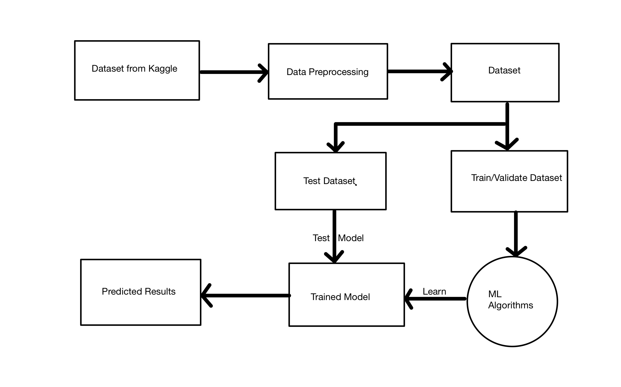
Schematic Layout
10

Slide 11
Algorithms used
Linear Regression: It is a machine learning algorithm based on supervised learning. It performs a regression task. Regression models a target prediction value based on independent variables. It is mostly used for finding out the relationship between variables and forecasting .
Decision Tree Regression: A decision tree is a decision support hierarchical model that uses a tree-like model of decisions and their possible consequences, including chance event outcomes, resource costs, and utility.
Random Forest Regression: The Random Trees algorithm is a sophisticated modern approach to supervised learning for categorical or continuous targets. The algorithm uses groups of classification or regression trees and randomness to make predictions that are particularly robust when applied to new observations.
Support Vector Regression: Support Vector Machine(SVM) supervised machine learning algorithm used for both classification and regression. The objective of the SVM algorithm is to find a hyperplane in an N-dimensional space that distinctly classifies the data points.
Extreme Gradient Boost Regression: XGBoost (eXtreme Gradient Boosting) is an open source library which provides a regularizing gradient boosting framework for C++, JAVA, PYTHON etc.
11

Slide 12
Experimentation and Results
System Specifications
Processor: intel i5 8th Gen(Quad-Core)
Graphics: Nvidia GeForce MX130 & Intel(R) UHD Graphics 620
Memory:12 GB RAM
Storage: 512 GB SSD(Solid State Drive) & 1 TB HDD( Hard Disk Drive)
Wireless Connectivity: 2 x 2 802.11n
Tech Stack
IDE Used: Jupyter Notebook, Eclipse, VS code
Python Libraries : NumPy, Pandas, datetime, seaborn, warning, matplotlib
Dataset Reference: kaggle

Slide 13
Experimentation and Results Contd..
Dataset Description
We have chosen a dataset from kaggle.
Diverse collection of B2B invoice data, including purchase, sales, and service invoices from different industries and businesses. Each invoice was labeled with invoice number, date, vendor/customer details, item descriptions, quantities, prices and total amount.
Data Preprocessing: AI-Enabled techniques for converting scanned invoices to machine-readable text. Text extraction methods to identify invoice fields. Data cleaning and normalization to handle inconsistencies and errors.

Slide 14
Experimentation and Results Contd..
Parameters used
Data Extraction: AI models are trained to identify and extract specific data fields. This includes extracting key information like vendor name, invoice date, due date, item details,etc.
Machine Learning Algorithms: ML algorithms are trained on large datasets of invoices to learn patterns and make predictions. The algorithms we used are Linear Regression, Random Forest Regression, SVM and XGBoost.

Slide 15
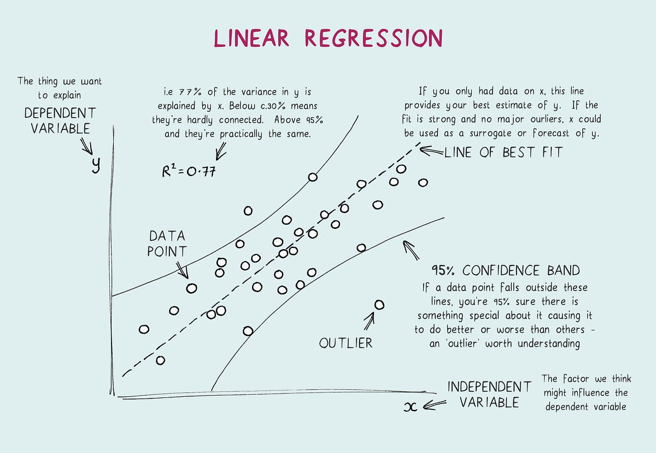
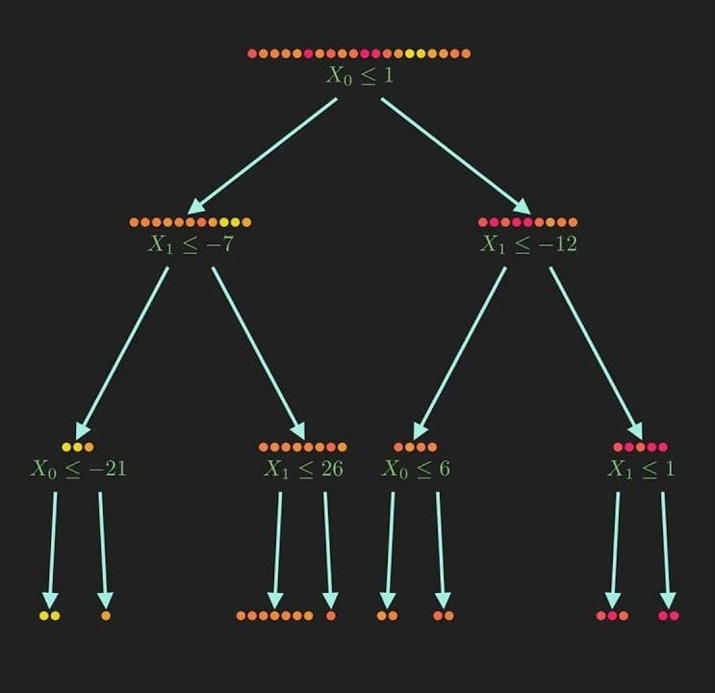
Experimentation and Results Contd..
Experimental outcomes (Tables and Figures)
Simple Linear Regression Model Decision Tree Regression

Slide 16
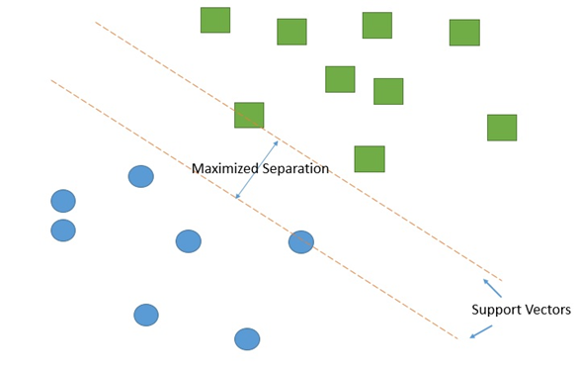
Experimentation and Results (Contd.)
Explanation of Support Vector Machine

Slide 17

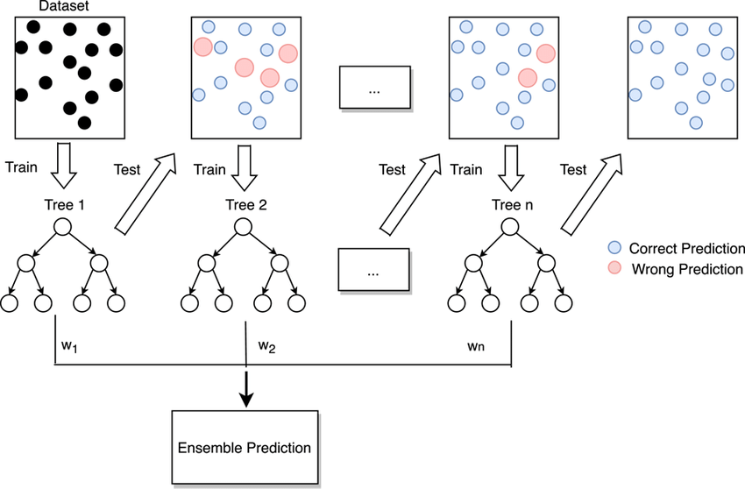
Experimentation and Results (Contd.)
Random Forest Gradient Boosting

Slide 18
Experimentation and Results Contd..
Result Analysis and Validation
Regression | MSE | R2
Simple Linear Regression | 291933297245.28125 | 6.36
Decision Tree Regression | 0.3624230697331672 | -0.006461419989768125
Support Vector Machine | 265485977144.60446 | 105543979685.65639
Random Forest | 0.4201835284498934 | 0.7694938973693469
Gradient Boosting | 1.221049e+11 | 0.706788

Slide 19
Conclusion and Future Scope (Key Findings)
The suggested system can analyze and classify invoices based on context and meaning, resulting in a more precise invoicing system.
Machine learning algorithms are used to find patterns and forecast outcomes, such as predicting when invoices will be approved or detecting potential fraud.
These distinctive characteristics of the system result in improved accuracy and efficiency in the invoicing process.
The suggested system has potential applications for the future, including the use of block chain technology to increase security and decrease fraud, and natural language generation to automatically generate invoices.
The system can be modified to meet specific organizational demands.
The system is adaptable to changes in the business environment in the future.
19

Slide 20
Bibliography
[1] Allen, J. (2021). Artificial intelligence in invoice management: improving accuracy and efficiency. Journal of Accountancy.
[2] Chaudhary, N., & Kumar, N. (2020). AI-based invoice management system for B2B companies. International Journal of Advanced Science and Technology, 29(6), 2082-2090.
[3] Fang, W., & Chen, C. (2021). The development of AI-based invoice management system for B2B companies: A case study. Journal of Industrial Engineering and Management Science, 4(1), 23-32.
[4] Kim, D. H., Kim, J. W., & Lee, K. H. (2020). An AI-based invoice management system for B2B SMEs. Journal of Open Innovation: Technology, Market, and Complexity, 6(2), 37.

Slide 21

21

